Slide 1
Challenge Problem 7: Influence-Like Illnesses
Ssu-Hsin Yu, SSCI
Tom Dietterich, Oregon State
Chad Scherrer, Galois

Slide 2
Influenza-Like Illnesses (ILI)
5 million cases of severe illness each year world wide
200,000-500,000 deaths annually
Spreads by
contact of mucous with eyes, nose, mouth
inhaled aerosol particles
touch (e.g., hand-to-hand or hand-surface-hand)
Virus is shed one-half to one-day after infection for a period of 5 days (longer in children and immunocompromised people)

Slide 3
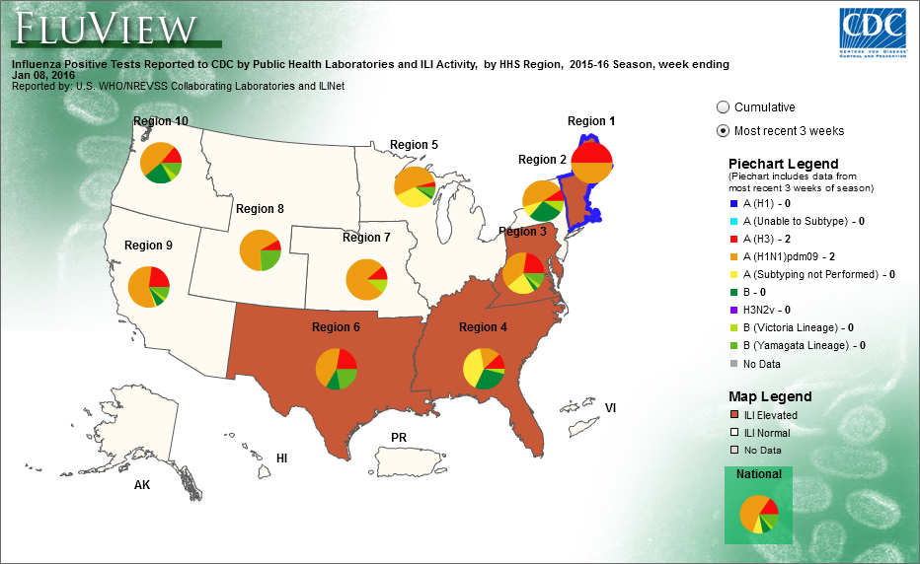
CDC U.S. Outpatient Influenza-like Illness Surveillance Network (ILINet)
Percentage of doctor visits that are flu-related
Weekly reports
Aggregated to CDC Regions
Broken out by age ranges
http://gis.cdc.gov/grasp/fluview/fluportaldashboard.html

Slide 4
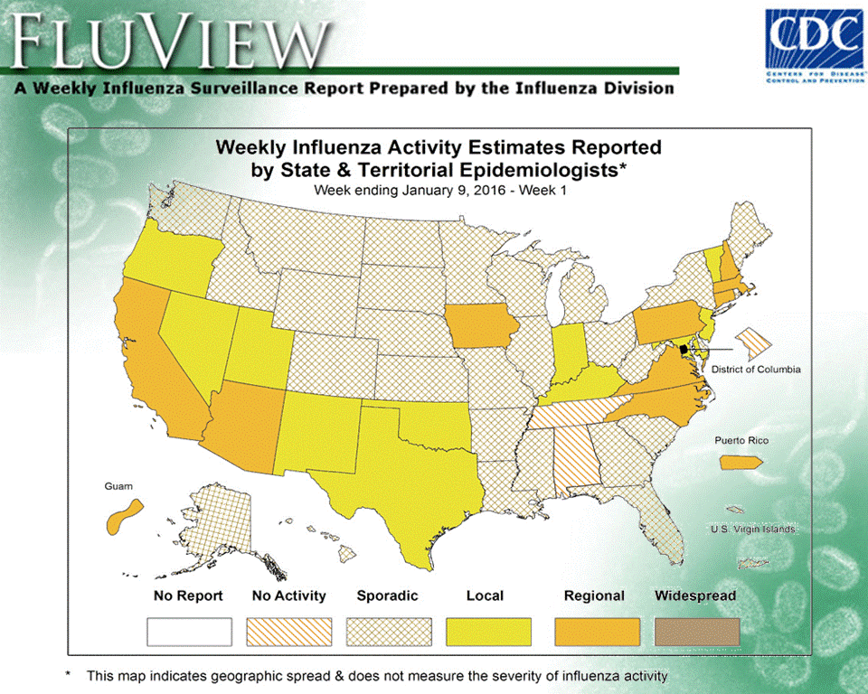
Weekly State-Level Estimates

Slide 5
State and County Reports (“Prediction Regions”)
County-level data
Massachusetts, North Carolina, Rhode Island and Texas
Within-state district data
Mississippi and Tennessee

Slide 6
Useful Covariates
Tweets (per county per week)
keywords “flu” and “influenza”
number of tweets (not retweets; no multiple tweets from same user within 5 days)
Cumulative Vaccination Percentage (weekly) of Medicare recipients
Demographic information (population by age brackets)
Geographic information: adjacent counties

Slide 7
Example Tweets

Slide 8
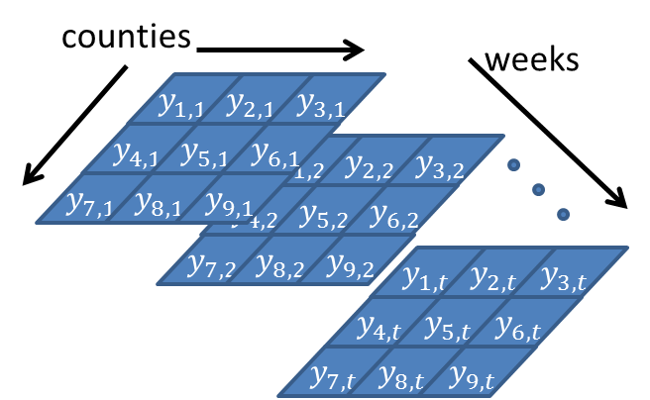
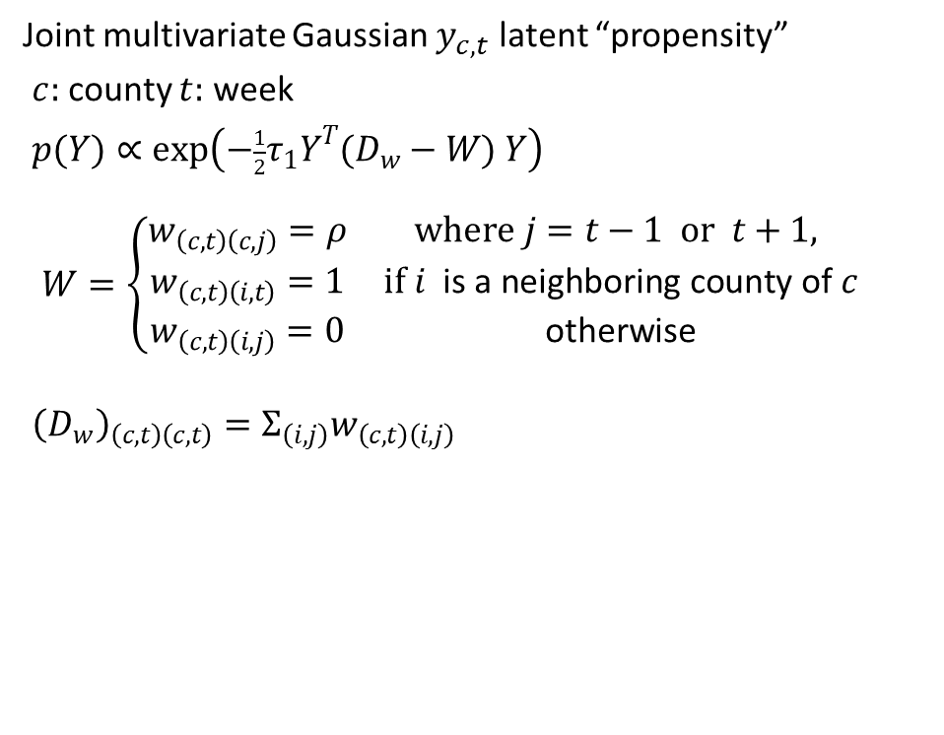
Proposed Model
Joint multivariate Gaussian $y_{c,t}$ latent “propensity”
$c:$ county $t:$ week
$p(Y)∝\exp\left(−\frac{1}{2}τ_{1}Y^{T}(D_{w}−W) Y\right)$
$$W=\left\{\begin{matrix}\begin{matrix}w_{\left(c,t\right)\left(c,j\right)}=ρ & where j=t−1 or t+1, \\ w_{\left(c,t\right)\left(i,t\right)}=1 & if i \text{is} \text{a} \text{neighboring} \text{county} \text{of} c \\ w_{\left(c,t\right)\left(i,j\right)}=0 & \text{otherwise}\end{matrix} & \end{matrix}\right.$$
${\left(D_{w}\right)}_{\left(c,t\right)\left(c,t\right)}=Σ_{\left(i,j\right)}w_{\left(c,t\right)\left(i,j\right)}$

Slide 9
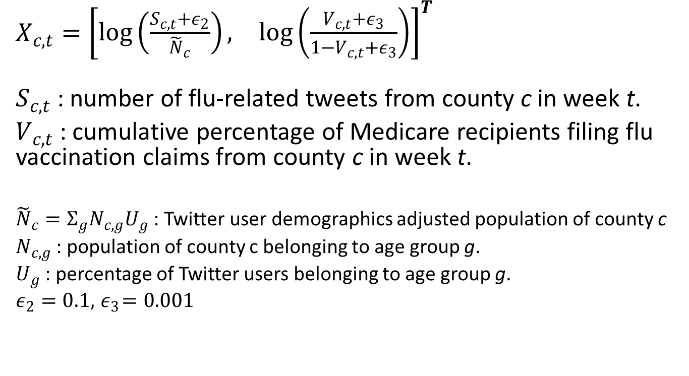
Covariates
$X_{c,t}={\left[\begin{matrix}\log\left(\frac{S_{c,t}+ε_{2}}{{\tilde{N}}_{c}}\right), & \log\left(\frac{V_{c,t}+ε_{3}}{1−V_{c,t}+ε_{3}}\right)\end{matrix}\right]}^{T}$
$S_{c,t}$ : number of flu-related tweets from county c in week t.
$V_{c,t}$ : cumulative percentage of Medicare recipients filing flu vaccination claims from county c in week t.
${\tilde{N}}_{c}=Σ_{g}N_{c,g}U_{g}$ : Twitter user demographics adjusted population of county c
$N_{c,g}$ : population of county c belonging to age group g.
$U_{g}$ : percentage of Twitter users belonging to age group g.
$ε_{2}=0.1, { ε}_{3}=0.001$

Slide 10
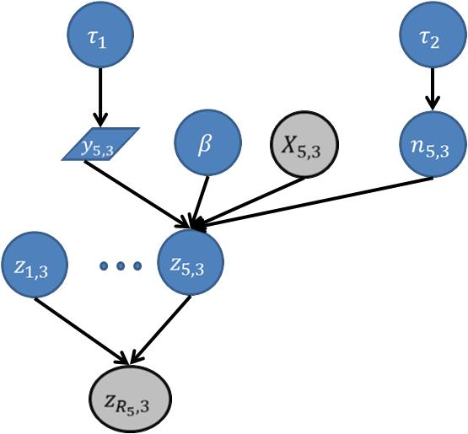
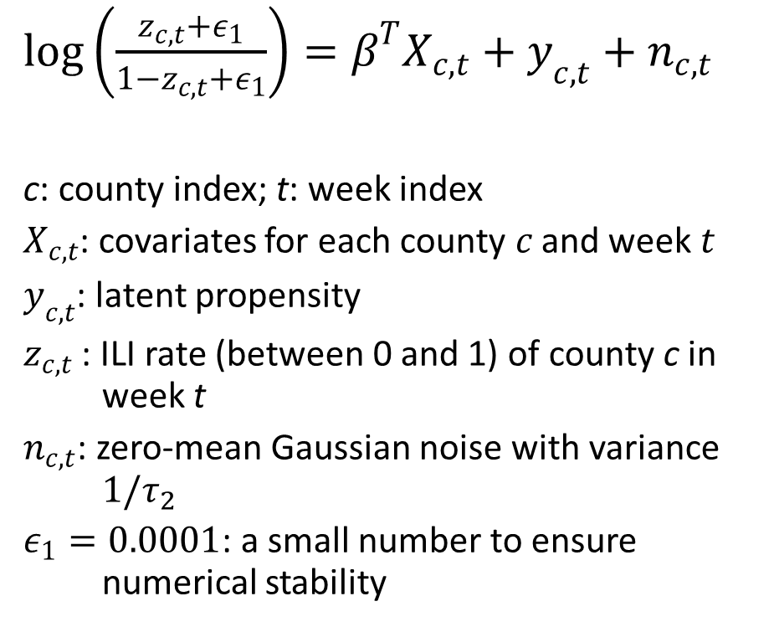
Flu Prevalence
$log\left(\frac{z_{c,t}+ε_{1}}{{1−z}_{c,t}+ε_{1}}\right)=β^{T}X_{c,t}+y_{c,t}+n_{c,t}$
c: county index; t: week index
$X_{c,t}$: covariates for each county $c$ and week $t$
$y_{c,t}$: latent propensity
$z_{c,t}$ : ILI rate (between 0 and 1) of county c in week t
$n_{c,t}$: zero-mean Gaussian noise with variance $1/τ_{2}$
$ε_{1}=0.0001$: a small number to ensure numerical stability

Slide 11
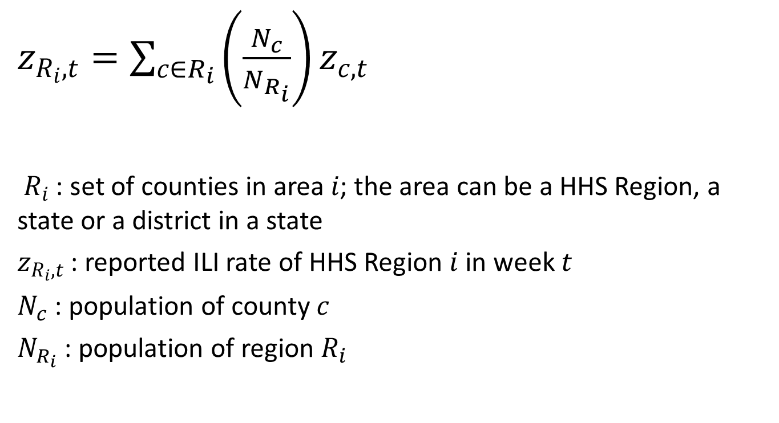
Aggregated Observations
$z_{R_{i},t}=\sum_{c∈R_{i}}{\left(\frac{N_{c}}{N_{R_{i}}}\right)}z_{c,t}$
${ R}_{i}$ : set of counties in area $i$; the area can be a HHS Region, a state or a district in a state
$z_{R_{i},t}$ : reported ILI rate of HHS Region $i$ in week $t$
$N_{c}$ : population of county $c$
$N_{R_{i}}$ : population of region $R_{i}$

Slide 12
Phase 1 Task: Reconstruction
Given:
weekly covariates and observations for an entire year
tweets, vaccination, CDC ILI reports + whole state estimates
Find:
weekly ILI prevalence for the Prediction Regions (counties and districts)
Metrics:
Population-adjusted Squared Error
Start and Peak of the epidemic

Slide 13
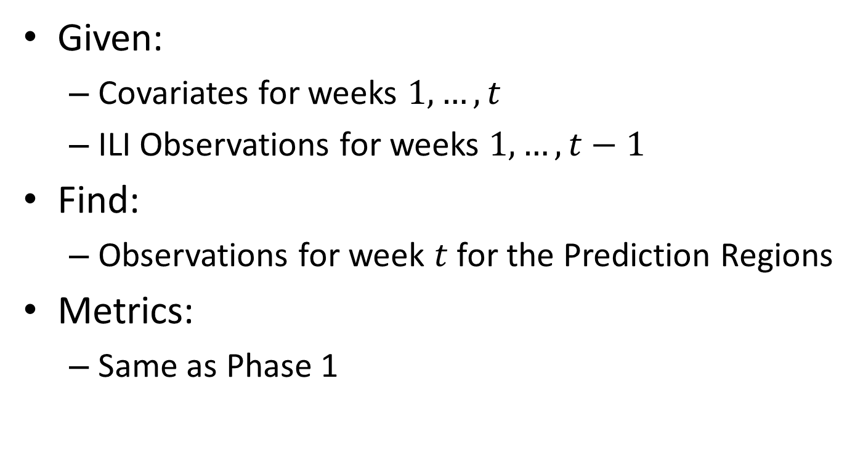
Phase 2 Task: Weekly Nowcast for 2015-16
Given:
Covariates for weeks $1,…,t$
ILI Observations for weeks $1,…,t−1$
Find:
Observations for week $t$ for the Prediction Regions
Metrics:
Same as Phase 1

Slide 14
Challenge Problem Dimensions
Domain Class
Data Structure
Model Structure
Query Structure
DoD-related
Platforms
ISR
C3
Intelligence Analysis
Types:
Continuous
Discrete
Hybrid
Directed?:
Directed
Undirected
Query Type:
MAP
Marginal MAP
Expectation
Posterior Distribution
Posterior Summary
Anomalies
Structure:
Vector
Relational
Sequence
Spatial
Parametric?:
Parametric
Nonparametric
Industry
Platforms
C3
# of Objects or Entities:
Fixed
Variable
Query Timing:
One shot
Amortized
Tracking
Medicine and Science
Bird migration
Brain segmentation
Influenza
Content:
Signals
Counts
Tracklets
Text
Images
3D MRI images
Aircraft tracks
Operational Tempo:
Fast
Slow
Latent Variables?:
Observed
Latent
Stationarity:
Stationary
Change points
Both

Slide 15
CP#7 Next Evaluation Period
Timeline
April 15-30: Beta Period
45 Days before PI meeting: Final Deadline for CP6 and CP7 solutions (~ June 6)
July ??: PI Meeting

Slide 16
CP#7 Materials Available Now
http://ppaml.galois.com/wiki/wiki/???
http://ppaml.kitware.com/midas/
Email address for questions, issues, etc.:
ppaml-support@community.galois.com
Micro-breakout ??? at ???

Slide 17
Future Challenge Problems
CP8: Recognition of Interleaved Desktop Activities
CP9: Anomaly Detection??
CP10: Integrating Multiple Learning Components Hackathon??
Micro-Breakout ?? at ??

